Slide 1
welcome TO OUR PRESENTATION find the decreasing of oxygen levels in atmosphere

Slide 2
Objectives
Introduction
Tools, Reference and Features
Composition of Earth
Physical reactions to changing oxygen levels
Advantage and disadvantage
Atmospheric oxygen levels are decreasing
How to find the decreasing of oxygen level ?
- Numerical Analysis of “ Newton backward interpolation formula ”
- Applying Formula
- Implementation
Some snap shot of our GUI and code
Some results of our project

Slide 3
Features
Tools
The key features of our project GUI –
Input Year
Calculate
Output
Result in Per Meg Unit
The result converted into Percentage value
Graph
Clear
MATLAB Application
(MATLAB interpreter)

Slide 4
Introduction
Oxygen is everywhere, but at its most basic, it is an element in the form of gas that makes up the Earth’s atmosphere and natural formations.
Oxygen gas makes up about 21% of the air in the earth’s atmosphere.
It makes up almost 65% of the human body when considered by mass.
It makes water when combined with two hydrogen atoms.
Do you know what the effect of oxygen is in the vast atmosphere around us?
At present, we breathe from the atmosphere 100 years ago, what was the status of the atmosphere?
Due to climate change in the present world, it has a profound impact on the atmosphere.
At it’s core there is an increase in the number of factories in the developed world, as well as the impact of modern urbanization.
This reduces the amount of oxygen in the air, increasing the amount of carbon dioxide, which is the main reason for the loss of ozone layer.
This change in the atmosphere is a serious threat to our planet. So we need to be conscious now.

Slide 5
Composition of Earth
Earth has 4 main systems that interact :
1. The Atmosphere – Air / Gas
2. The Hydrosphere - Water
3. The Biosphere - Life
4. The Geosphere – Land / Rock.

Slide 6

Decreasing of Oxygen Levels in Atmosphere

Slide 7
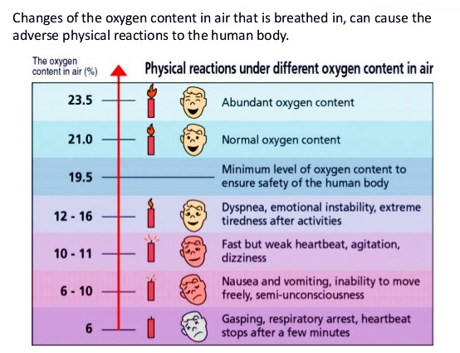
Changing oxygen levels and our physical reactions… Minimum 19% of Oxygen level we need to ensure safety.

Slide 8
Advantage and disadvantage
Oxygen is used by people, plants and animals for respiration.
The atmosphere today is about 21% oxygen. In former times it was different percentage. In dinosaur day’s it was closer to 30% which was a factor in animals growing as big as they did.
When pure O2 is introduced to the lungs, autonomic reflex increases respiration. The increased rate of breathing means that a much larger load of carbon dioxide is released from the body, which causes the blood vessels to constrict. Despite the increased amount of available oxygen in the lungs, the circulatory system is hampered, and cannot deliver precious O2 as well as it could when breathing normal atmosphere.
Atmospheric gases are non-toxic but alteration in their concentrations especially that of oxygen have an effect upon life and combustion process.
Oxygen is not flammable but it does support combustion.
If good practice is not observed accidents may happen as changes in concentration cannot be easily detected by the human sense.

Slide 9
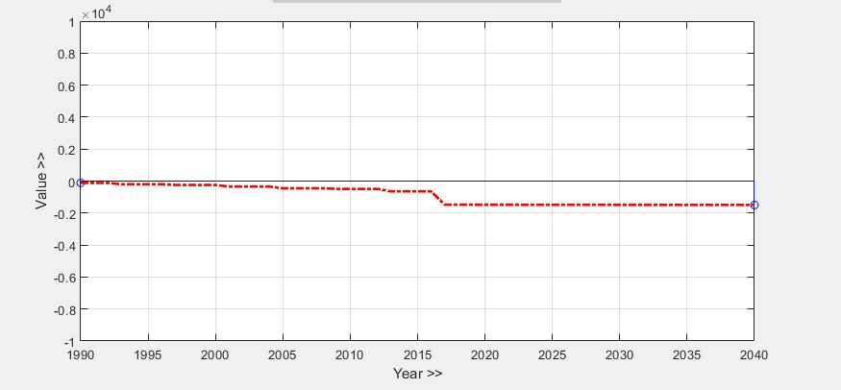
Atmospheric Oxygen Levels are Decreasing
Oxygen levels are decreasing globally due to fossil-fuel burning.
The changes are too small to have an impact on human health, but are of interest to the study of climate change and carbon dioxide.
These plots show the atmospheric O₂ concentration relative to the level around 1990.

Slide 10
How to Find The Decreasing of Oxygen Level ?
We take some data from online resources .
Then we sort those data and make a table, like
In Y section negative values means the decreasing level of Oxygen.
We use Newton Backward Interpolation Formula to find the next year decreasing level of Oxygen.
Then we write a code on MATLAB and find the next years decreasing level of Oxygen.
X (Year) | 1992 | 1996 | 2000 | 2004 | 2008 | 2012 | 2016
Y (O2 level) | -114.02 | -198.79 | -243.06 | -343.49 | -452.99 | -489.99 | -642.13

Slide 11
What is Newton Backward Interpolation Formula ??
Interpolation:
Interpolation consists in reading a value which lies between two extreme points.
Newton Backward Interpolation :
Newton’s forward interpolation formula cannot be used for interpolating a value of y near the end of a table of values. For this purpose, we use another formula known as Newton backward interpolation formula.
Formula: F(x)=Yn+(u*nabla5)+((u*(u+1)*nabla2y4)/2!)+((u*(u+1)*(u+2)*nabla3y3)/3!)+((u*(u+1)*(u+2)*(u+3)*nabla4y2)/4!)+((u*(u+1)*(u+2)*(u+3)*(u+4)*nabla5y1)/5!)+((u*(u+1)*(u+2)*(u+3)*(u+4)*(u+5)*nabla6y0)/6!)

Slide 12
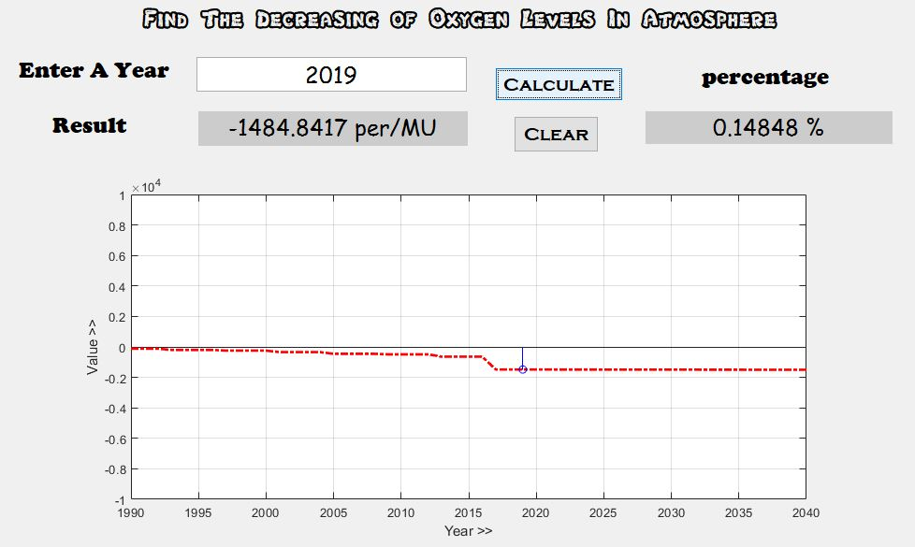
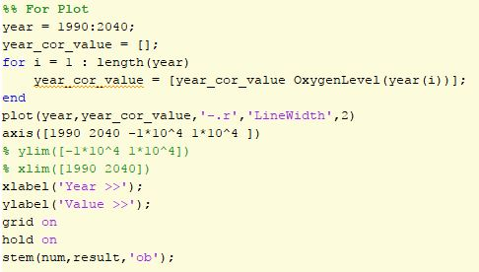


For Input, Result, Percentage And Plot

Slide 13
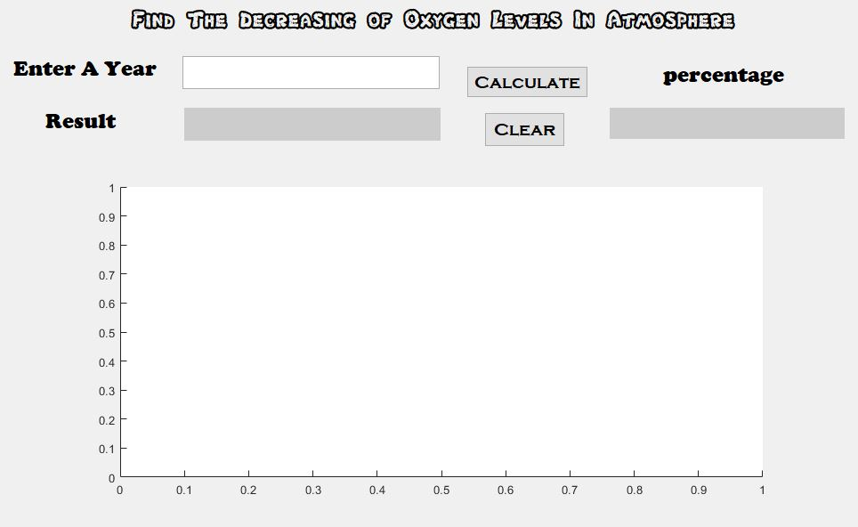

For Clear

Slide 14
Some result of our project is given bellow : Per Mega is a Measurement Unit. Per Mega = 0.001 per mil or 0.0001 percent or parts per million (ppm). The unit is typically used in isotope analysis. Here we attached my coding file :
X (Year) | 2007 | 2015 | 2024 | 2034
Y (Per Meg) | -452.1848 | -641.929 | -1488.43 | -1495.65

Slide 15
Reference
MATLAB Documentation
Mathworks®
Introductory Method Of Numerical Analysis – S.S Sastry
Numerical Analysis – Shahadat Hossain
YouTube

Slide 16
Thank You

